Slide 1


Lecture 8
DLI
Limit Theorems
极限定理

Slide 2
DLI
Outline
Chebyshev‘s Inequality and the Weak Law of Large Numbers 切比雪夫不等式和弱大数定律
The Central Limit Theorem 中心极限定理
The Strong Law of Large Numbers 强大数定律

Slide 3
DLI
Introduction
The most important theoretical results in probability theory are limit theorems. Of these, the most important are those classified either under the heading laws of large numbers or under the heading central limit theorems.
Usually, theorems are considered to be laws of large numbers if they are concerned with stating conditions under which the average of a sequence of random variables converges (in some sense) to the expected average.
By contrast, central limit theorems are concerned with determining conditions under which the sum of a large number of random variables has a probability distribution that is approximately normal.

Slide 4
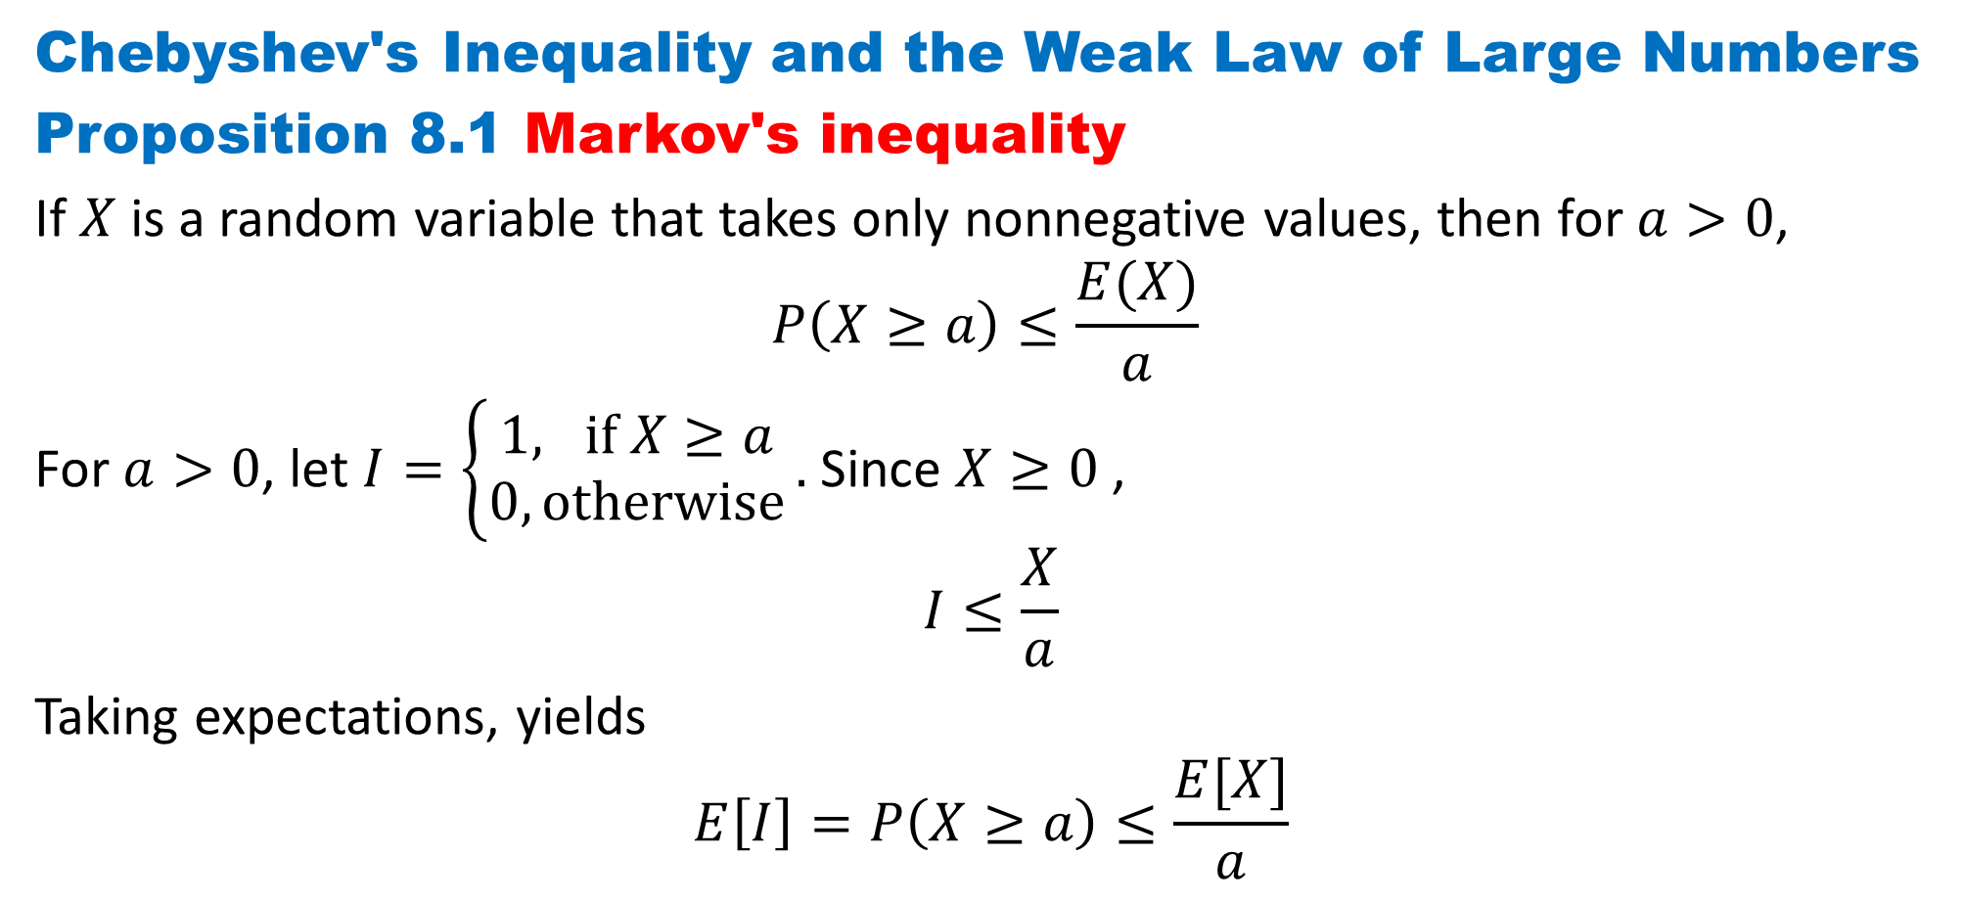
DLI
Chebyshev's Inequality and the Weak Law of Large Numbers
Proposition 8.1 Markov's inequality
If $X$ is a random variable that takes only nonnegative values, then for $a>0$,
$$P\left(X≥a\right)≤\frac{E(X)}{a}$$
For $a>0$, let $I=\left\{\begin{aligned}1, if X≥a \\ 0, otherwise\end{aligned}\right..$ Since $X≥0$ ,
$$I≤\frac{X}{a}$$
Taking expectations, yields
$$E\left[I\right]=P\left(X≥a\right)≤\frac{E[X]}{a}$$

Slide 5
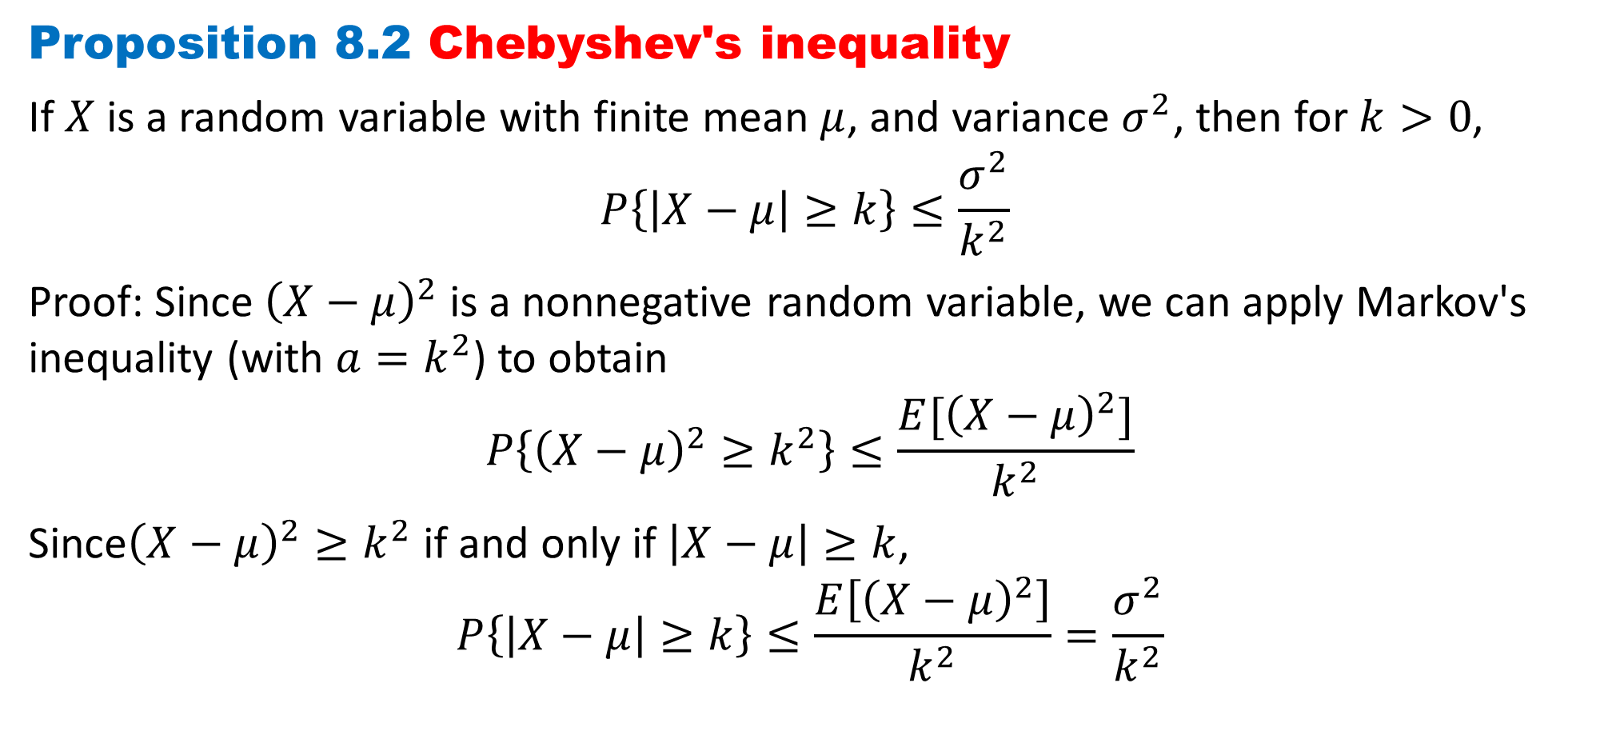
DLI
Proposition 8.2 Chebyshev's inequality
If $X$ is a random variable with finite mean $μ$, and variance $σ^{2}$, then for $k>0$,
$$P\left\{\left|X−μ\right|≥k\right\}≤\frac{σ^{2}}{k^{2}}$$
Proof: Since ${\left(X−μ\right)}^{2}$ is a nonnegative random variable, we can apply Markov's inequality (with $a=k^{2}$) to obtain
$$P\left\{{\left(X−μ\right)}^{2}≥k^{2}\right\}≤\frac{E[{\left(X−μ\right)}^{2}]}{k^{2}}$$
Since${\left(X−μ\right)}^{2}≥k^{2}$ if and only if $\left|X−μ\right|≥k$,
$$P\left\{\left|X−μ\right|≥k\right\}≤\frac{E\left[{\left(X−μ\right)}^{2}\right]}{k^{2}}=\frac{σ^{2}}{k^{2}}$$

Slide 6
DLI
The importance of Markov's and Chebyshev's inequalities is that they enable us to derive bounds on probabilities when only the mean or both the mean and the variance of the probability distribution are known. Of course, if the actual distribution were known, then the desired probabilities could be computed exactly and we would not need to resort to bounds.

Slide 7
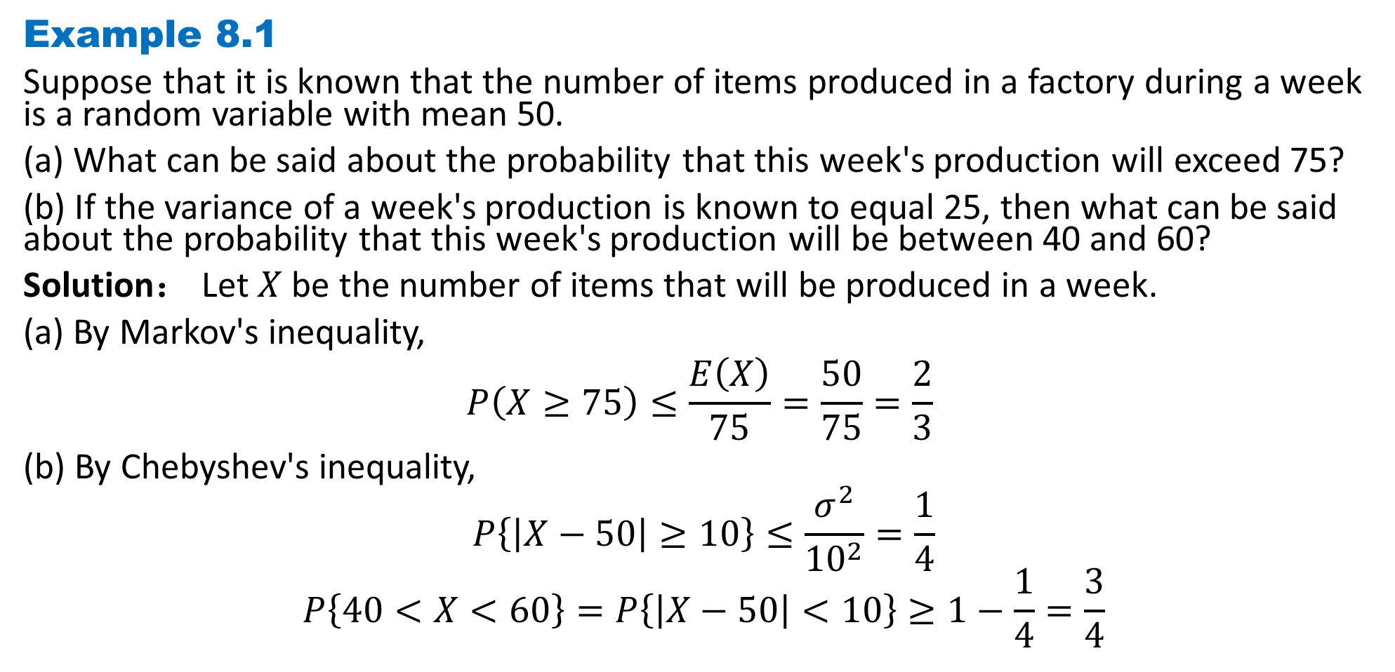
DLI
Example 8.1
Suppose that it is known that the number of items produced in a factory during a week is a random variable with mean 50.
(a) What can be said about the probability that this week's production will exceed 75?
(b) If the variance of a week's production is known to equal 25, then what can be said about the probability that this week's production will be between 40 and 60?
Solution： Let $X$ be the number of items that will be produced in a week.
(a) By Markov's inequality,
$$P\left(X≥75\right)≤\frac{E\left(X\right)}{75}=\frac{50}{75}=\frac{2}{3}$$
(b) By Chebyshev's inequality,
$$P\left\{\left|X−50\right|≥10\right\}≤\frac{σ^{2}}{{10}^{2}}=\frac{1}{4}$$
$$P\left\{40<X<60\right\}=P\left\{\left|X−50\right|<10\right\}≥1−\frac{1}{4}=\frac{3}{4}$$

Slide 8
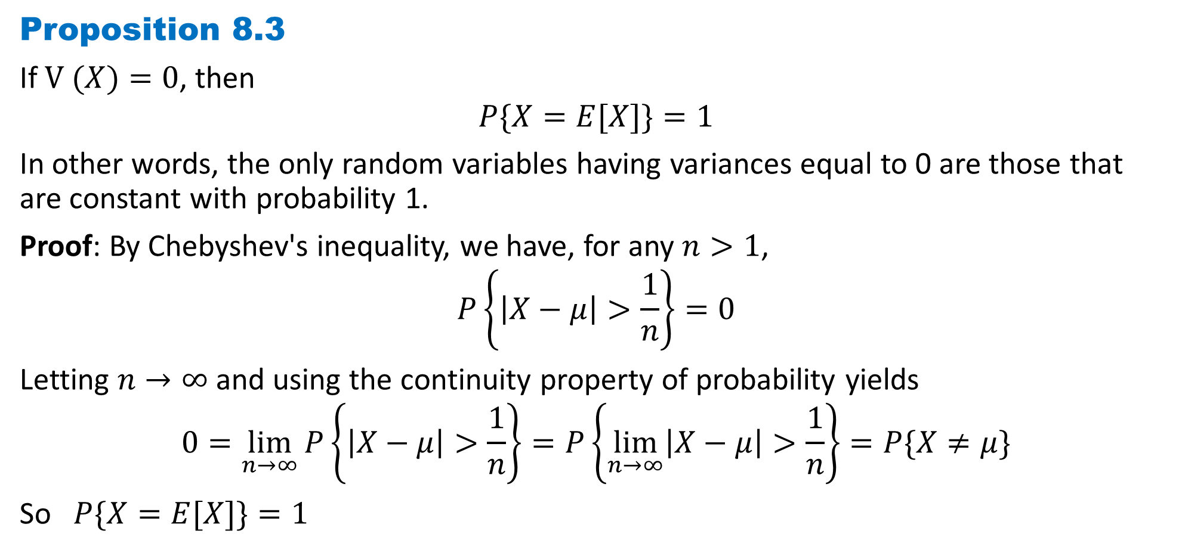
DLI
Proposition 8.3
If $V (X)=0$, then
$$P\{X=E[X]\}=1$$
In other words, the only random variables having variances equal to 0 are those that are constant with probability 1.
Proof: By Chebyshev's inequality, we have, for any $n>1$,
$$P\left\{\left|X−μ\right|>\frac{1}{n}\right\}=0$$
Letting $n→∞$ and using the continuity property of probability yields
$$0=\lim_{n→∞}{P\left\{\left|X−μ\right|>\frac{1}{n}\right\}}=P\left\{\lim_{n→∞}\left|X−μ\right|>\frac{1}{n}\right\}=P\{X≠μ\}$$
So $P\{X=E[X]\}=1$

Slide 9
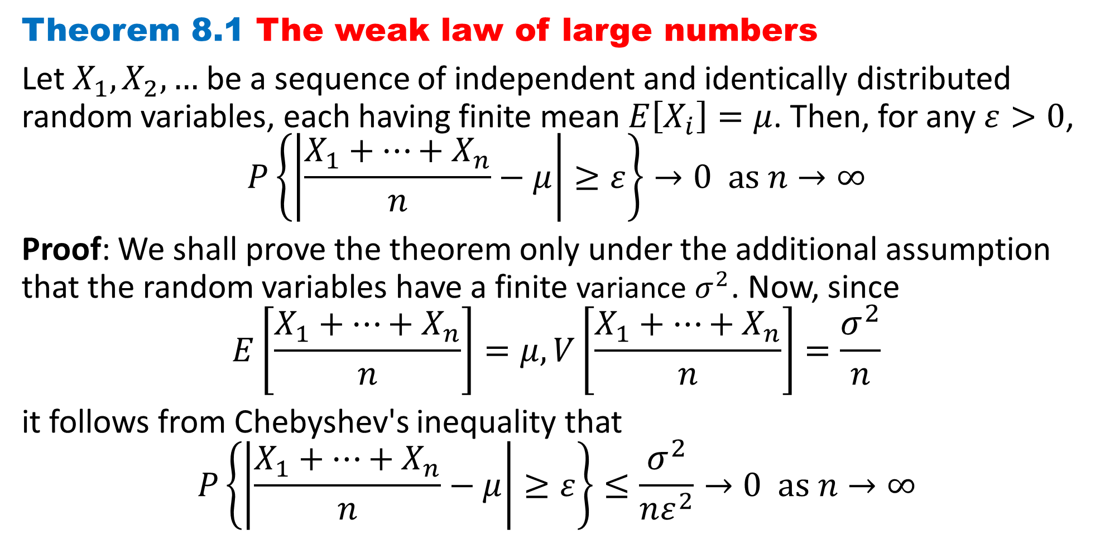
DLI
Theorem 8.1 The weak law of large numbers
Let $X_{1},X_{2}, …$be a sequence of independent and identically distributed random variables, each having finite mean $E\left[X_{i}\right]=μ$. Then, for any $ε>0$,
$$P\left\{\left|\frac{X_{1}+⋯+X_{n}}{n}−μ\right|≥ε\right\}→0 as n→∞$$
Proof: We shall prove the theorem only under the additional assumption that the random variables have a finite variance $σ^{2}$. Now, since
$$E\left[\frac{X_{1}+⋯+X_{n}}{n}\right]=μ,V\left[\frac{X_{1}+⋯+X_{n}}{n}\right]=\frac{σ^{2}}{n}$$
it follows from Chebyshev's inequality that
$$P\left\{\left|\frac{X_{1}+⋯+X_{n}}{n}−μ\right|≥ε\right\}≤\frac{σ^{2}}{nε^{2}}→0 as n→∞$$

Slide 10
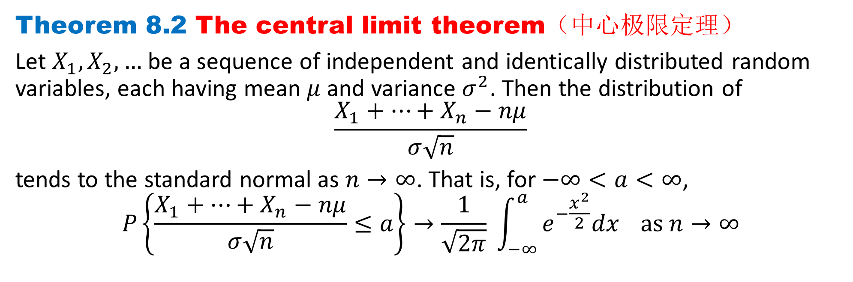
DLI
Theorem 8.2 The central limit theorem（中心极限定理）
Let $X_{1},X_{2}, …$be a sequence of independent and identically distributed random variables, each having mean $μ$ and variance $σ^{2}$. Then the distribution of
$$\frac{X_{1}+⋯+X_{n}−nμ}{σ\sqrt{n}}$$
tends to the standard normal as $n→∞$. That is, for $−∞<a<∞$,
$$P\left\{\frac{X_{1}+⋯+X_{n}−nμ}{σ\sqrt{n}}≤a\right\}→\frac{1}{\sqrt{2π}} \int_{−∞}^{a}{e^{−\frac{x^{2}}{2}}dx} as n→∞$$

Slide 11
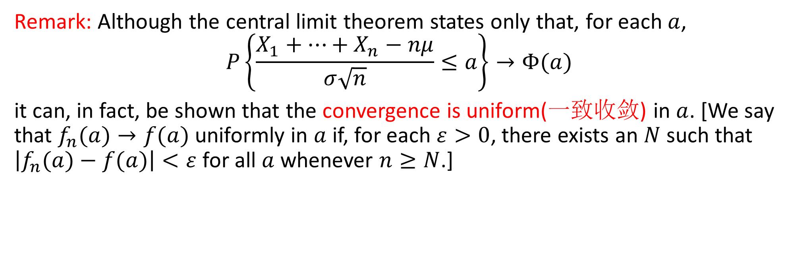
DLI
Remark: Although the central limit theorem states only that, for each $a$,
$$P\left\{\frac{X_{1}+⋯+X_{n}−nμ}{σ\sqrt{n}}≤a\right\}→Φ(a)$$
it can, in fact, be shown that the convergence is uniform(一致收敛) in $a$. [We say that $f_{n}(a)→f(a)$ uniformly in $a$ if, for each $ε>0$, there exists an $N$ such that $\left|f_{n}(a)−f(a)\right|<ε$for all $a$ whenever $n≥N$.]

Slide 12
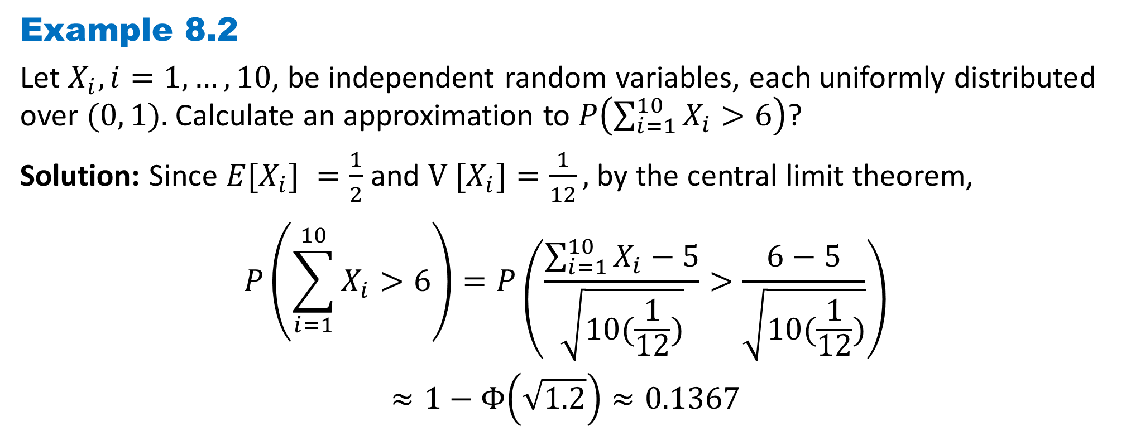
DLI
Example 8.2
Let $X_{i}, i=1, …, 10$, be independent random variables, each uniformly distributed over $(0, 1).$Calculate an approximation to $P\left(\sum_{i=1}^{10}{X_{i}}>6\right)$?
Solution: Since $E[X_{i}] =\frac{1}{2}$ and $V [X_{i}]=\frac{1}{12},$by the central limit theorem,
$$P\left(\sum_{i=1}^{10}{X_{i}}>6\right)=P\left(\frac{\sum_{i=1}^{10}{X_{i}}−5}{\sqrt{10(\frac{1}{12})}}>\frac{6−5}{\sqrt{10(\frac{1}{12})}}\right)$$
$$≈1−Φ\left(\sqrt{1.2}\right)≈0.1367$$

Slide 13
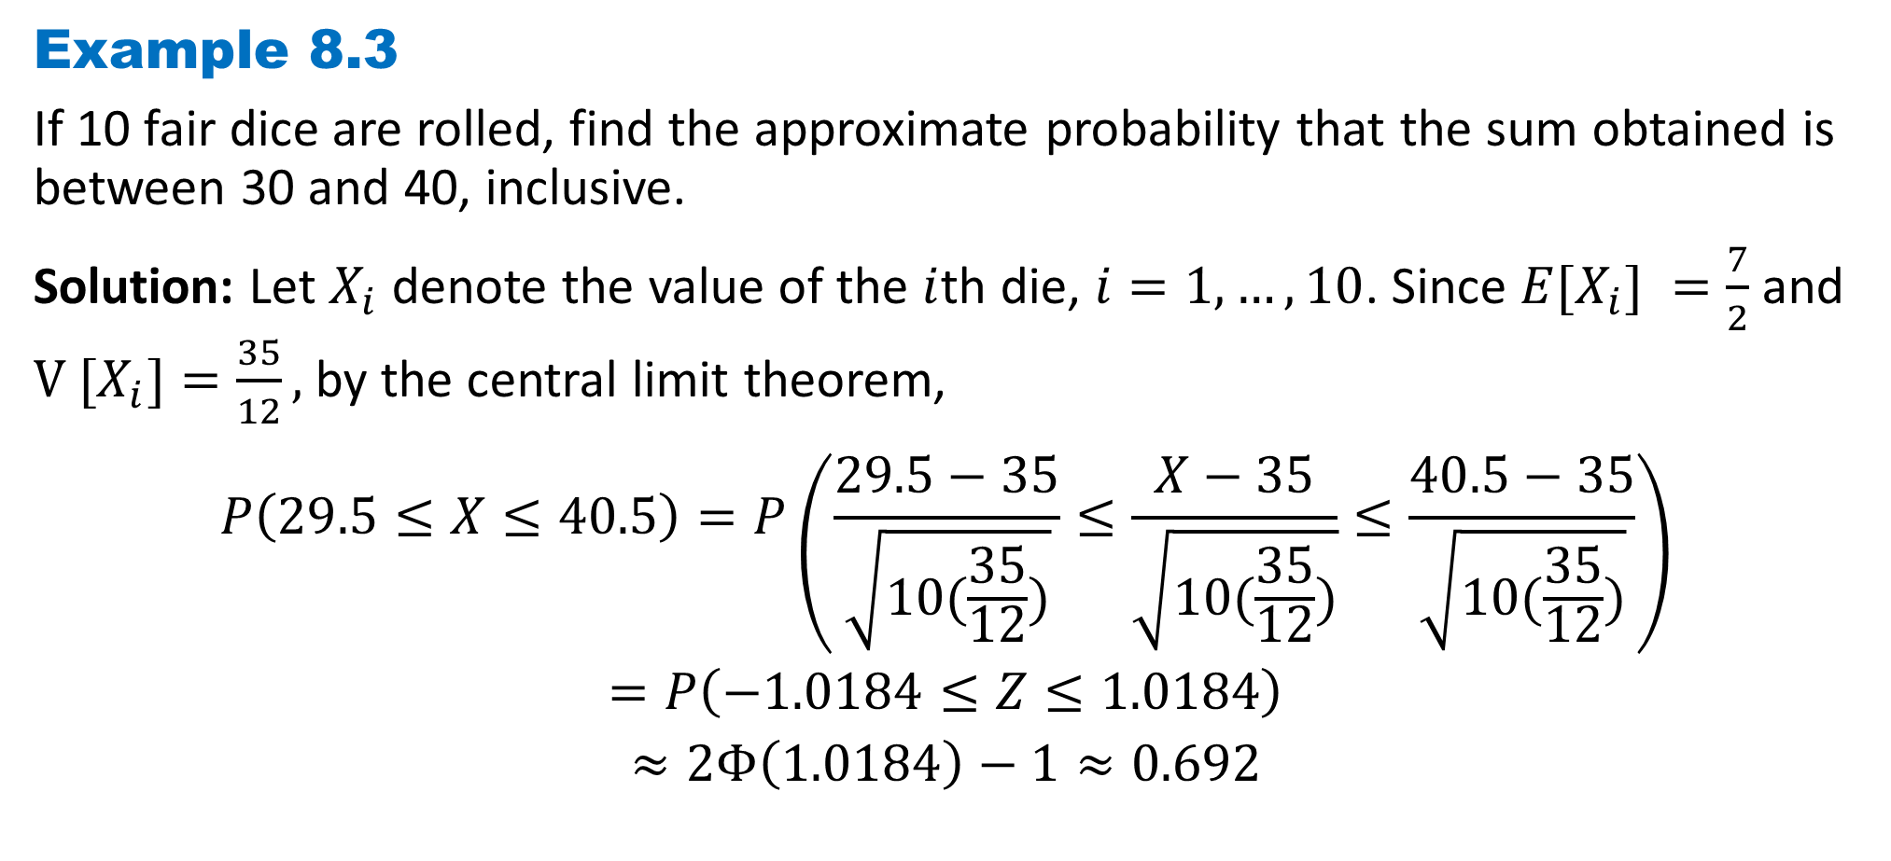
DLI
Example 8.3
If 10 fair dice are rolled, find the approximate probability that the sum obtained is between 30 and 40, inclusive.
Solution: Let $X_{i}$ denote the value of the $i$th die, $i=1, …, 10$. Since $E[X_{i}] =\frac{7}{2}$ and $V [X_{i}]=\frac{35}{12},$by the central limit theorem,
$$P\left(29.5≤X≤40.5\right)=P\left(\frac{29.5−35}{\sqrt{10(\frac{35}{12})}}≤\frac{X−35}{\sqrt{10(\frac{35}{12})}}≤\frac{40.5−35}{\sqrt{10(\frac{35}{12})}}\right)$$
$$=P\left(−1.0184≤Z≤1.0184\right)$$
$$≈2Φ\left(1.0184\right)−1≈0.692$$

Slide 14
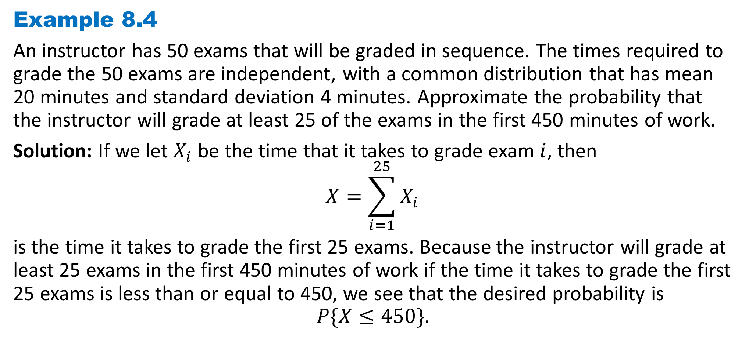
DLI
Example 8.4
An instructor has 50 exams that will be graded in sequence. The times required to grade the 50 exams are independent, with a common distribution that has mean 20 minutes and standard deviation 4 minutes. Approximate the probability that the instructor will grade at least 25 of the exams in the first 450 minutes of work.
Solution: If we let $X_{i}$ be the time that it takes to grade exam $i$, then
$$X=\sum_{i=1}^{25}{X_{i}}$$
is the time it takes to grade the first 25 exams. Because the instructor will grade at least 25 exams in the first 450 minutes of work if the time it takes to grade the first 25 exams is less than or equal to 450, we see that the desired probability is
$$P\{X≤450\}.$$

Slide 15
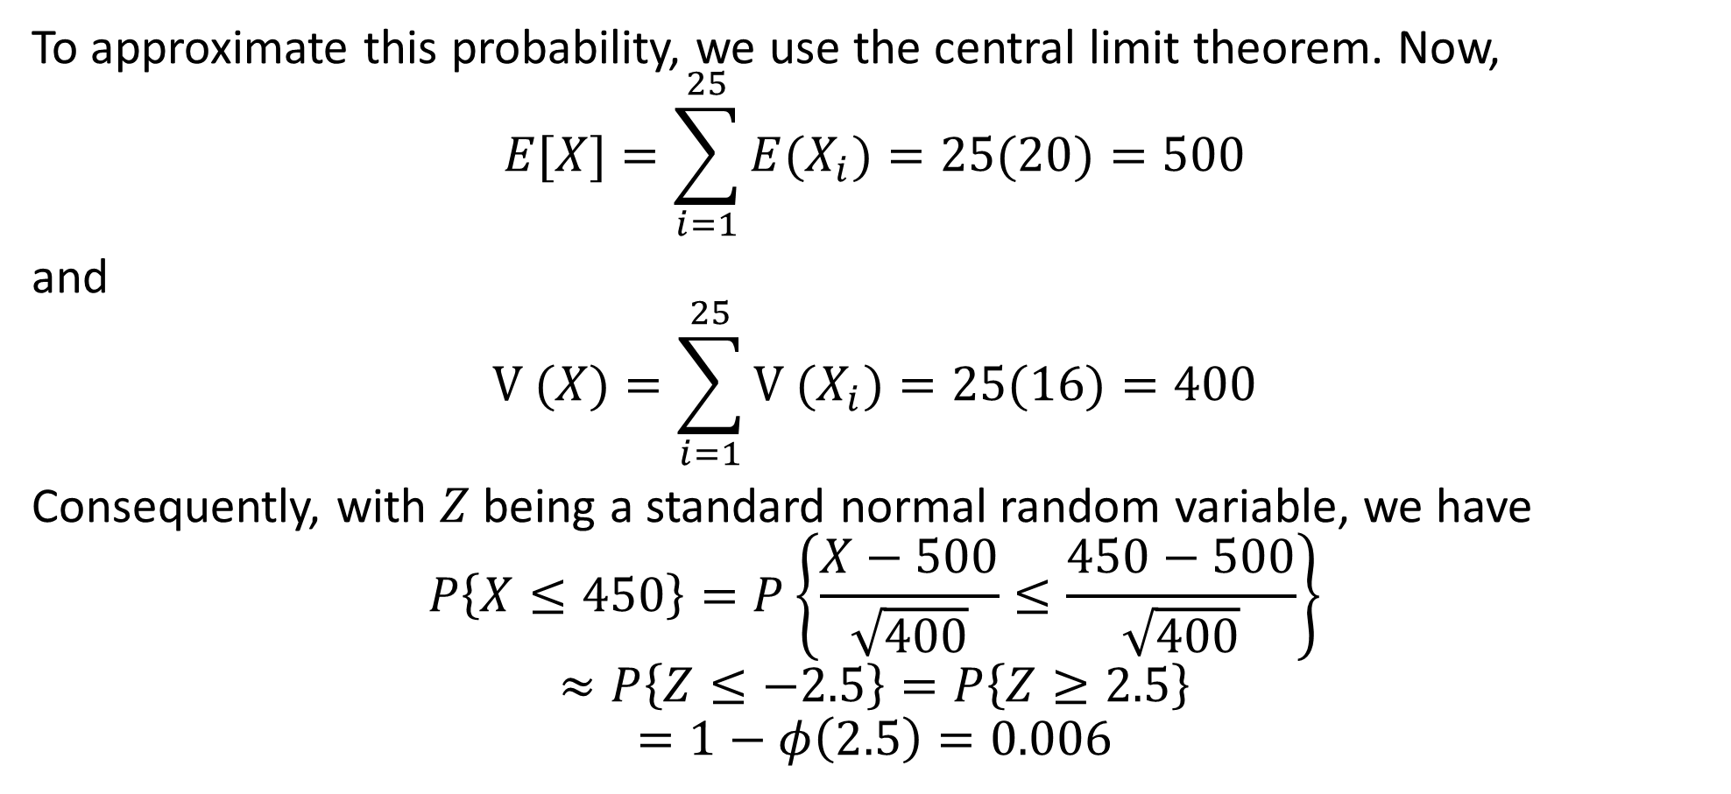
DLI
To approximate this probability, we use the central limit theorem. Now,
$$E[X]=\sum_{i=1}^{25}{E(X_{i})}=25(20)=500$$
and
$$V (X)=\sum_{i=1}^{25}{V (X_{i})}=25(16)=400$$
Consequently, with $Z$ being a standard normal random variable, we have
$$P\left\{X≤450\right\}=P\left\{\frac{X−500}{\sqrt{400}}≤\frac{450−500}{\sqrt{400}}\right\}$$
$$≈P\left\{Z≤−2.5\right\}=P\left\{Z≥2.5\right\}$$
$$=1−φ\left(2.5\right)=0.006$$

Slide 16
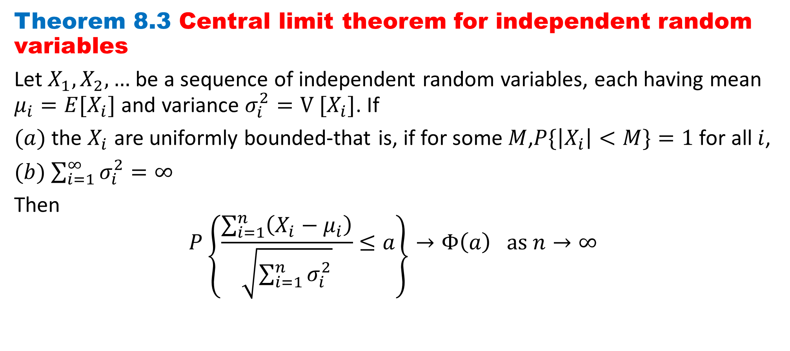
DLI
Theorem 8.3 Central limit theorem for independent random variables
Let $X_{1},X_{2}, …$be a sequence of independent random variables, each having mean $μ_{i}=E[X_{i}]$ and variance $σ_{i}^{2}=V [X_{i}]$. If
$(a)$the $X_{i}$ are uniformly bounded-that is, if for some $M$,$P\{\left|X_{i}\right|<M\}=1$for all $i$,
$(b)$ $\sum_{i=1}^{∞}{σ_{i}^{2}}=∞$
Then
$$P\left\{\frac{\sum_{i=1}^{n}{\left(X_{i}−μ_{i}\right)}}{\sqrt{\sum_{i=1}^{n}{σ_{i}^{2}}}}≤a\right\}→Φ\left(a\right) as n→∞$$

Slide 17
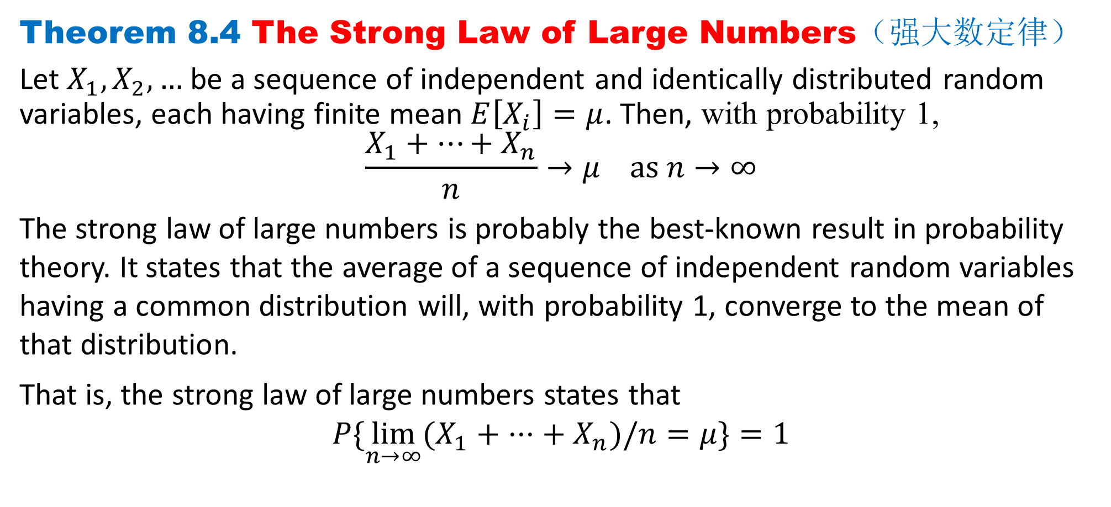
DLI
Theorem 8.4 The Strong Law of Large Numbers（强大数定律）
Let $X_{1},X_{2}, …$be a sequence of independent and identically distributed random variables, each having finite mean $E\left[X_{i}\right]=μ$. Then, with probability 1,
$$\frac{X_{1}+⋯+X_{n}}{n}→μ as n→∞$$
The strong law of large numbers is probably the best-known result in probability theory. It states that the average of a sequence of independent random variables having a common distribution will, with probability 1, converge to the mean of that distribution.
That is, the strong law of large numbers states that
$$P\{\lim_{n→∞}{(X_{1}+ ···+ X_{n})/n=μ\}}=1$$

Slide 18
DLI
Homework
Page 420 Problems
1, 4, 13, 15
Page 422 Theoretical Exercises
1, 2
Page 423 Self-Test Problems and Exercises
1, 2, 8

